Slide 1
AWS Guard Duty Azure Security Center
AWS Guard Duty & Azure Security Center
Orhen Hasday
Jul-21

Slide 2
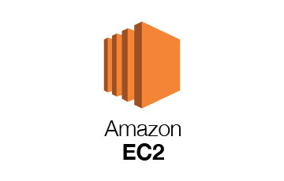


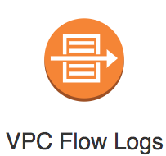
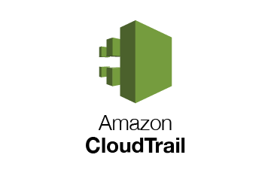

AWS Guard Duty
AWS DNS logs
https://docs.aws.amazon.com/guardduty/latest/ug/guardduty_data-sources.html

Slide 3
AWS Guard Duty AWS Security Hub Azure Defender Azure Security Center

Slide 4
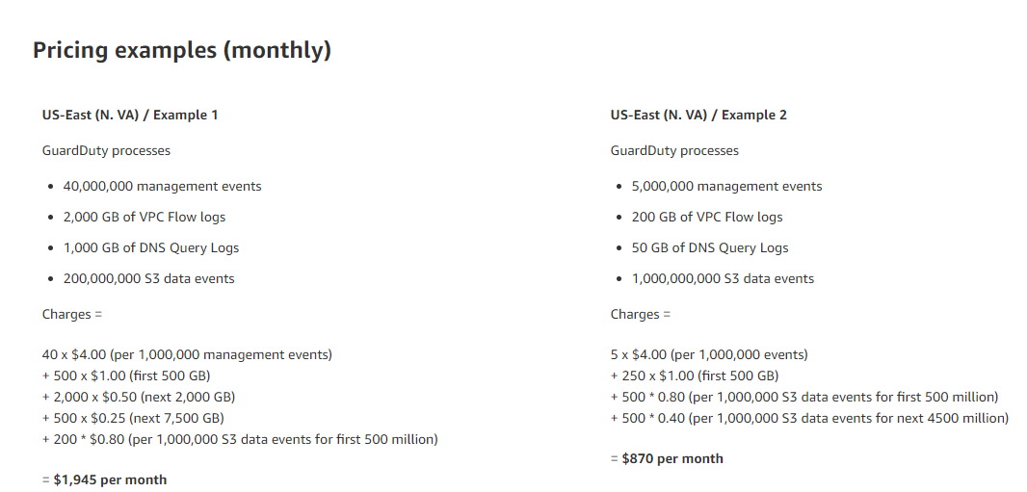
AWS Guard Duty (cost)
Price in each region would be different.

Slide 5
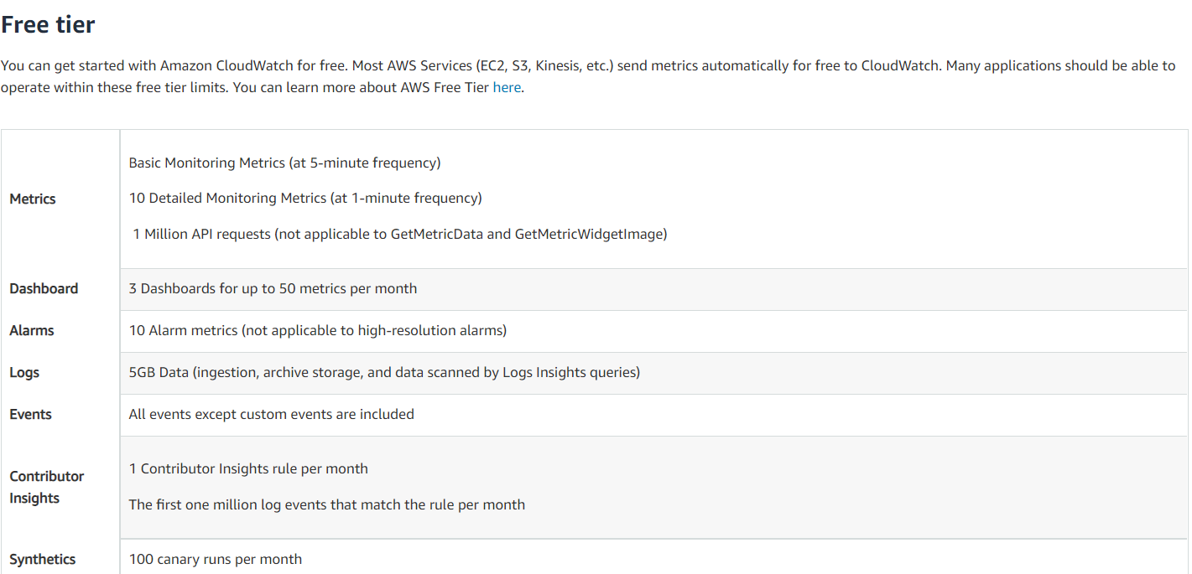
AWS CloudWatch (Cost Calculation) – Free Tier
No up front or minimum fee
Pay what you use

Slide 6
AWS CloudWatch (Cost) – Paid Tier
GetMetricData: Number of metrics requested
GetMetricData: Number of metrics requested
No up front or minimum fee
Pay what you use
Billing at the end of the month
Amazon CloudWatch Pricing – Amazon Web Services (AWS)
Metrics
Number of Metrics (includes detailed and custom metrics)
APIs
GetMetricData: Number of metrics requested
GetMetricWidgetImage: Number of metrics requested
Number of other API requests
GetMetricStatistics, ListMetrics, PutMetricData, GetDashboard, ListDashboards, PutDashboard and DeleteDashboards requests are the other request types which are billed at the same price.
Logs
Standard Logs: Data Ingested in GB
Vended Logs: Data Ingested
VPC and Route53 logs qualify for Vended Logs pricing.
Log Storage/Archival (Standard and Vended Logs)
Log volume archived is estimated to be 15% of Log volume ingested (due to compression). Storage/Archival costs are estimated assuming customer choses a retention period of one (1) month. Default retention setting is ‘never expire’. ( assuming 1 month retention)
Logs Delivered to S3: Data Ingested
VPC flow logs and Global Accelerator flow logs also qualify for this pricing.
Logs Insights Queries (Analyse Log Data)
Expected Logs Data scanned
Events
Number of Custom/Cross-account events
Dashboards and Alarms
Number of Dashboard
Number of Standard Resolution Alarm Metrics
Standard Resolution Alarms (60 seconds).
Number of High Resolution Alarm Metrics
High Resolution Alarm (10 seconds).
Number of composite alarms
Composite alarms can combine any type of CloudWatch alarm. Metric alarms are billed based on the number of metrics per alarm, while composite alarms are billed per alarm unit.
Canaries
Number of Canary runs
Contributor Insights for CloudWatch Logs
Number of Contributor Insights rules for CloudWatch
Total number of matched log events for CloudWatch
Contributor Insights for DynamoDB
Number of Contributor Insights rules for DynamoDB
Total number of events for DynamoDB
Lambda Insights
Number of Lambda functions
Number of requests per function

Slide 7
AWS CloudTrail (Cost Calculation) – Free Tier

Slide 8
AWS CloudTrail (Cost Calculation) – Paid Tier

Slide 9
AWS Security Hub (cost)
2 pricing dimensions for Security Hub:
Number of security checks per account/region/month
First 100,000 Checks | $0.001
Next 400,000 Checks | $0.0008
Above 500,000 Checks | $0.0005
Number of finding ingestion events per account/region/month
Perpetual Tier of 10000 | Free
After the first 10,000 | $0.00003
Customers are not charged for finding ingestion events generated by Security Hub’s security checks

Slide 10
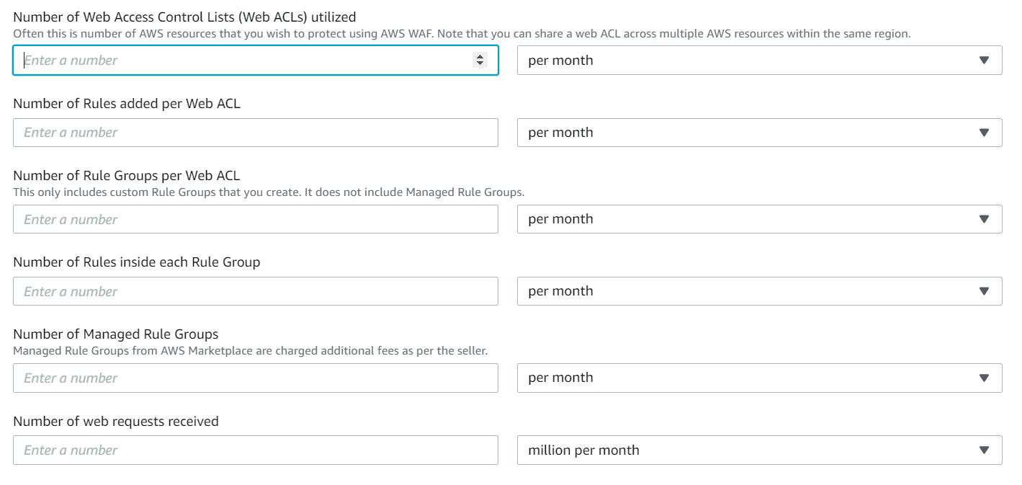
AWS WAF (cost)
Pricing - AWS WAF - Amazon Web Services (AWS)

Slide 11
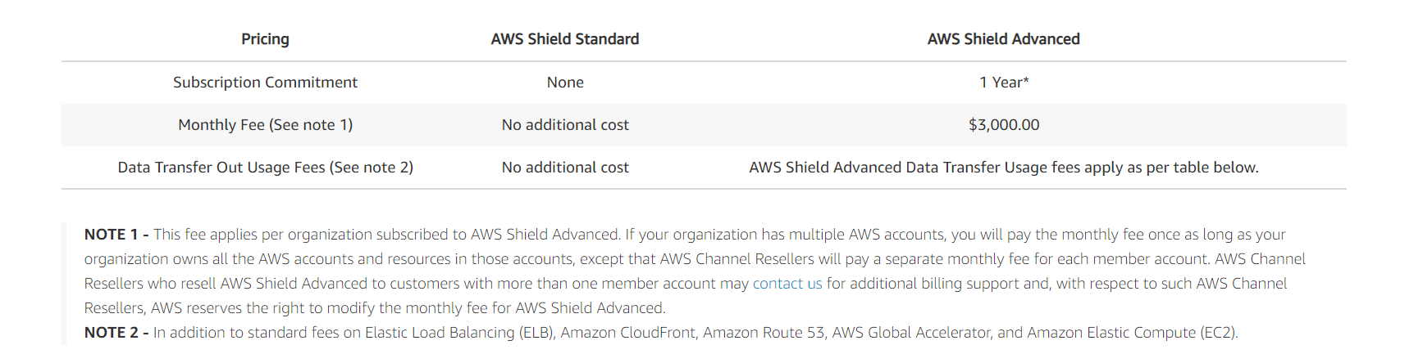
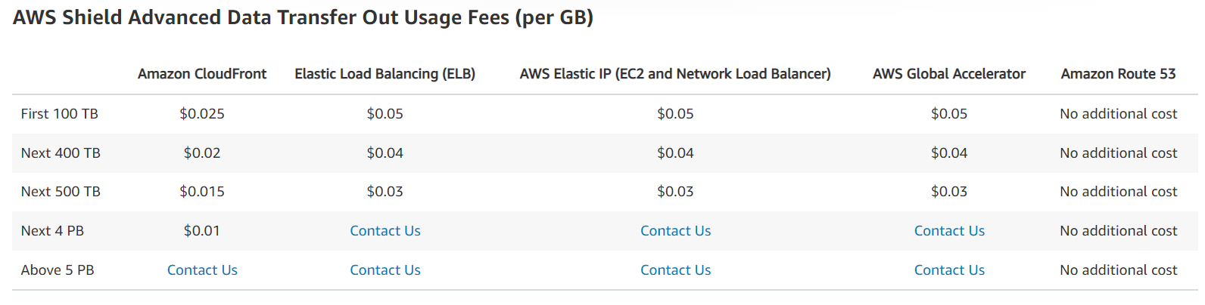
AWS Shield (cost)

Slide 12
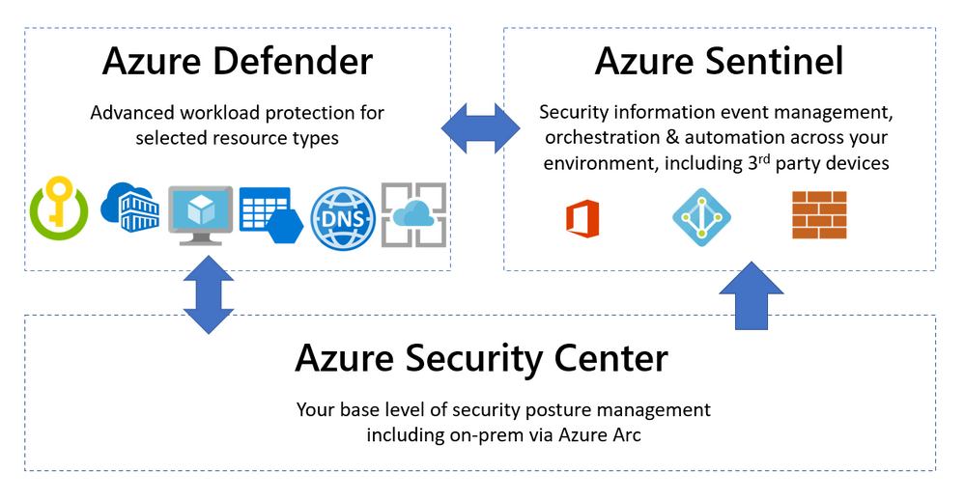
Azure Security Center
https://query.prod.cms.rt.microsoft.com/cms/api/am/binary/RE4s2L2
Azure Security Center provides unified security management and advanced threat protection across hybrid cloud workloads (both azure based, inhouse resources).

Slide 13
Azure Defender
Azure Defender. Is configured to add additional security alerts and advanced threat detection for certain types of resources.
Available for servers, app service, Storage, SQL, Key Vault, Resource Manager, DNS, Kubernetes and container registries

Slide 14
Azure Defender ( Services covered)
Services Covered:
Servers
App Service
SQL on Azure
SQL outside Azure
MySQL
PostgreSQL
MariaDB
Storage - Protect all storage accounts within a subscription1 10K transactions
Kubernetes vCore/hour
ACR /image
Key Vault /10K transactions
ARM /1M API calls
DNS

Slide 15
Azure Defender ( Services covered)
Services Covered:
Servers
App Service
SQL on Azure
SQL outside Azure
MySQL
PostgreSQL
MariaDB
Storage - Protect all storage accounts within a subscription1 10K transactions
Kubernetes vCore/hour
ACR /image
Key Vault /10K transactions
ARM /1M API calls
DNS

Slide 16
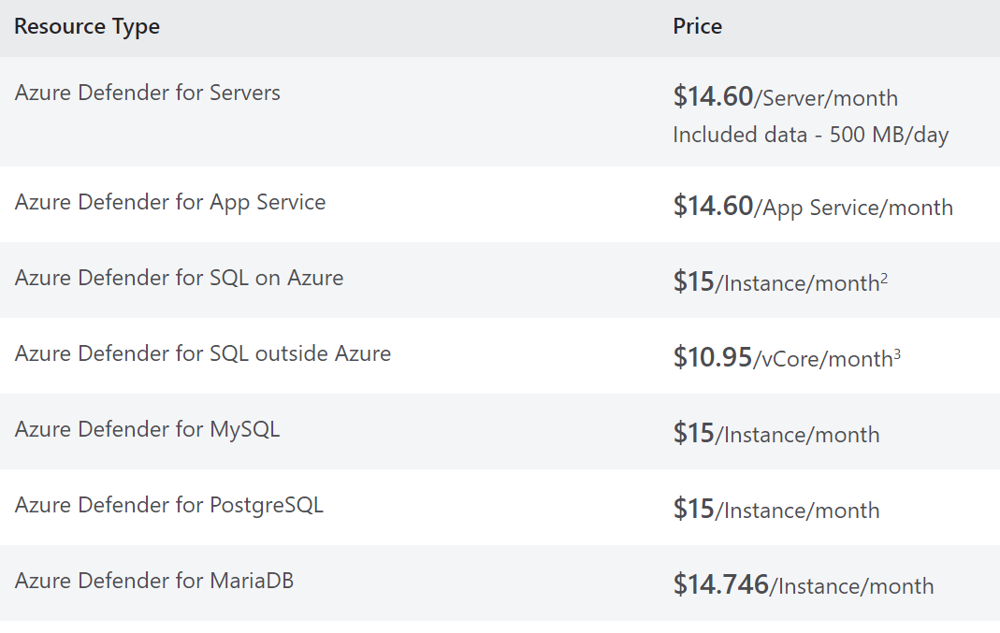
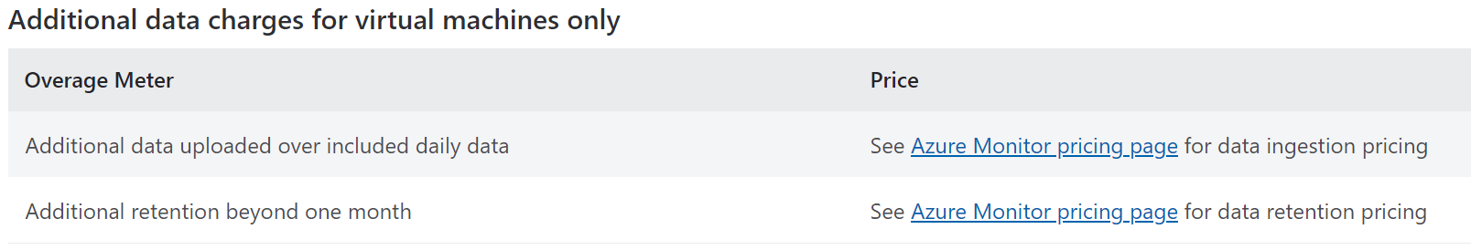
Azure Security Center (cost)
Azure Security Center has 2 offerings:
Azure Security Center free
Azure Defender
If you enable Azure Defender for subscription, all resources would be part of Pricing.
To enable it for certain resources in a resource type enable it through workspace
Pricing across regions are almost similar with very small variation.
Pricing is bases on Resource type:
Pricing—Azure Defender | Microsoft Azure

Slide 17
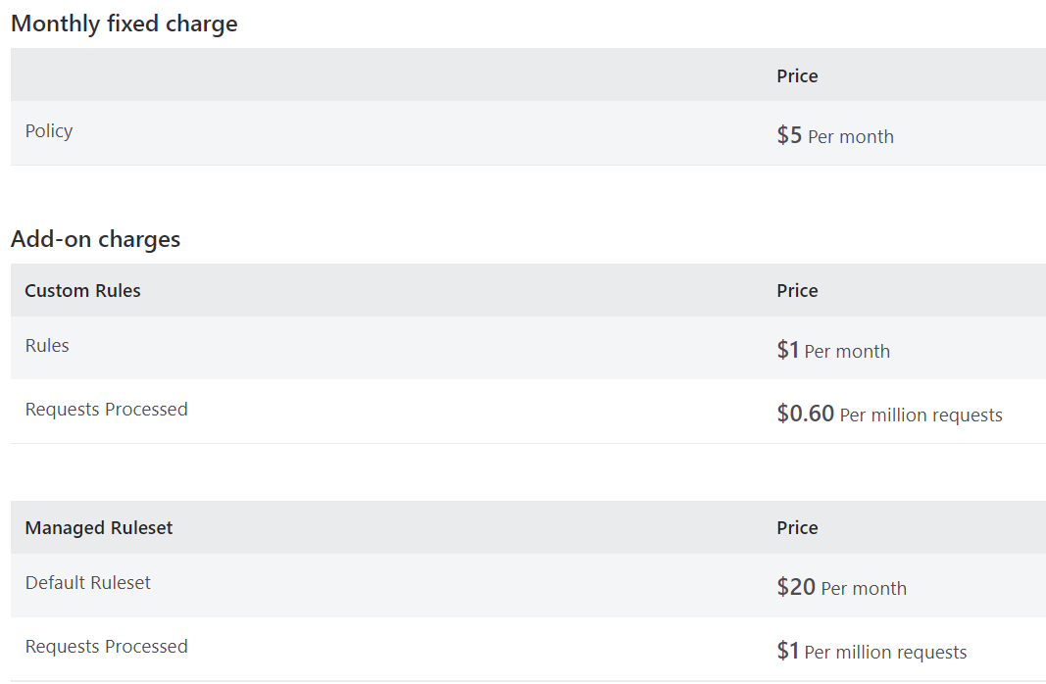
Azure WAF
Azure Web Application Firewall protects your web applications from bot attacks and common web vulnerabilities such as SQL injection and cross-site scripting.
WAF pricing includes:
Monthly fixed charges and
Request based processing charges.
Monthly charge for each policy and
Add-on charges for Custom Rules and Managed Rulesets as configured in the policy.

Slide 18
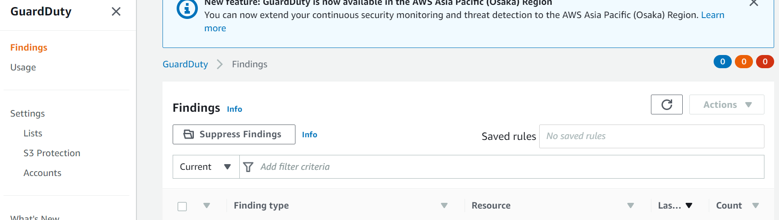
Configuration- AWS GuardDuty

Slide 19
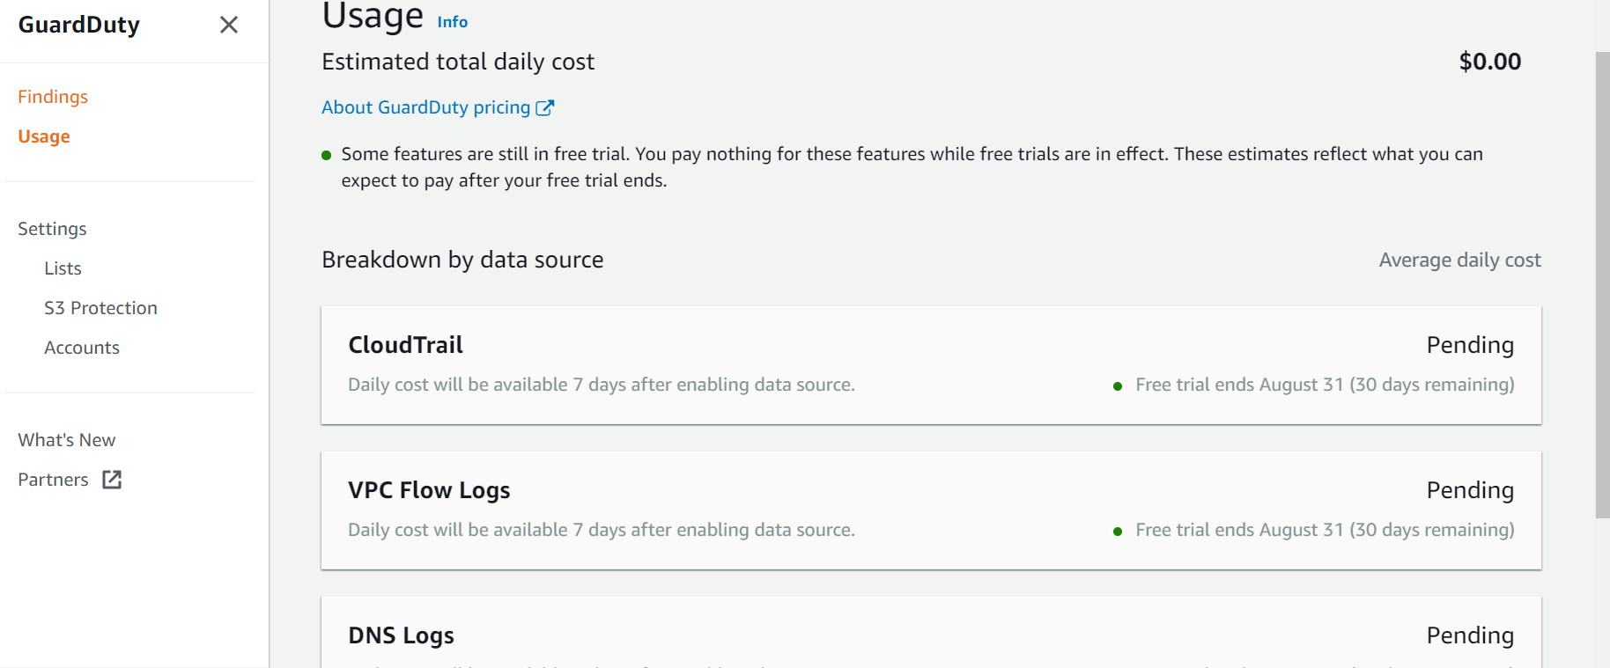
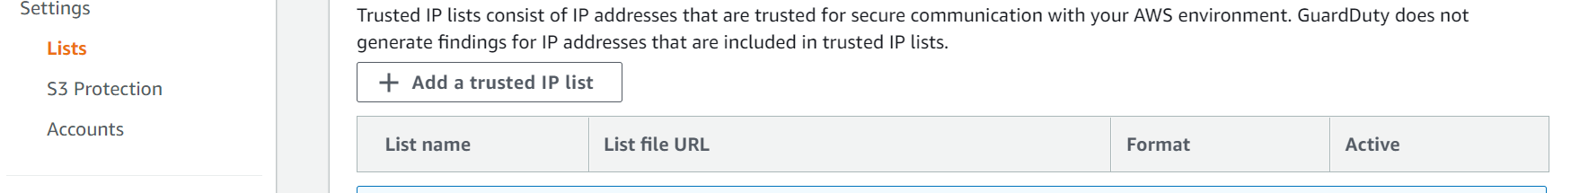
Configuration- AWS GuardDuty

Slide 20
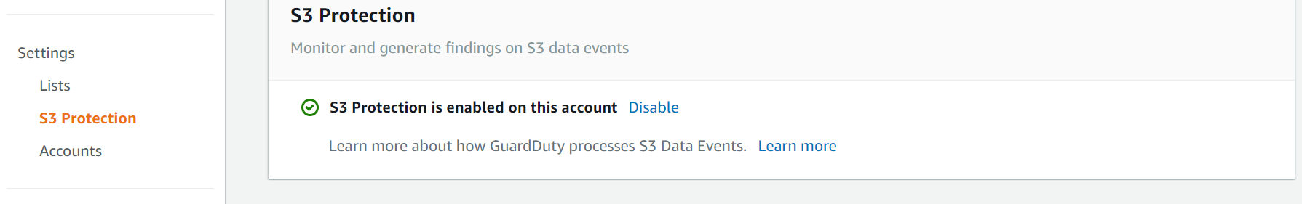
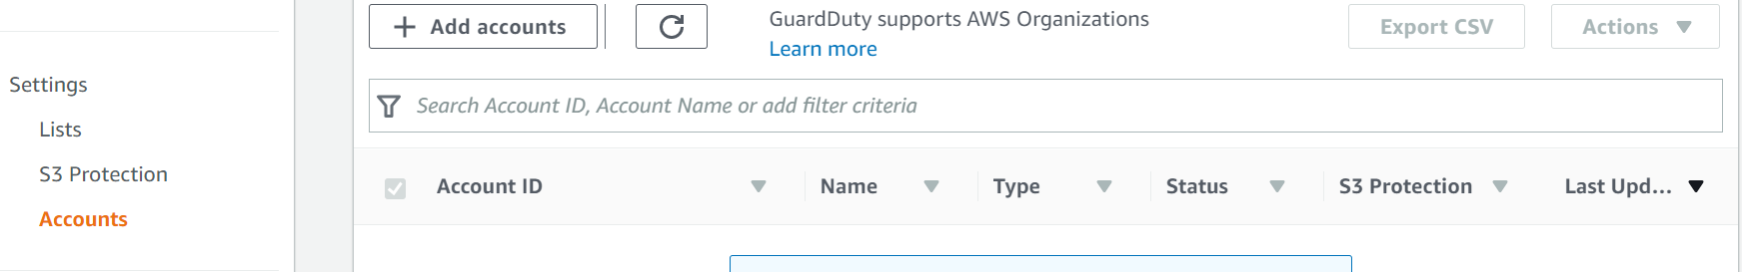
Configuration- AWS GuardDuty

Slide 21
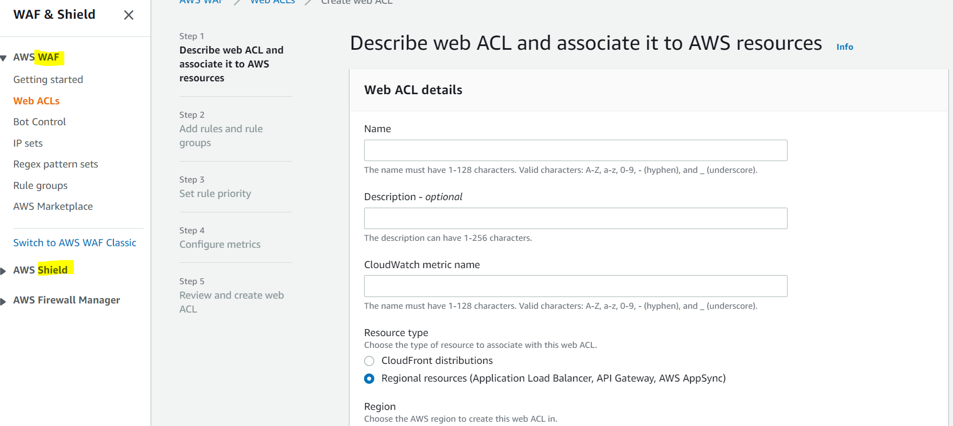
Configuration- AWS WAF

Slide 22
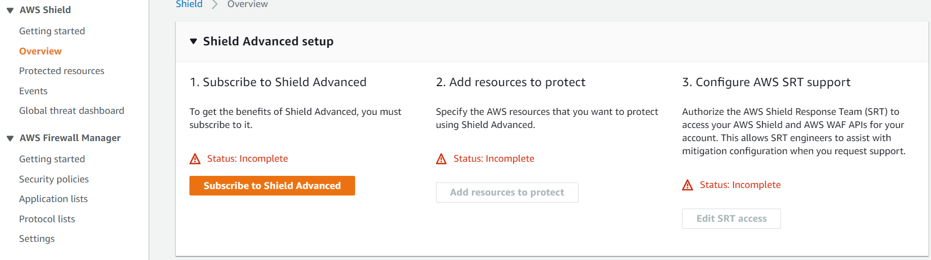
Configuration- AWS Shield

Slide 23
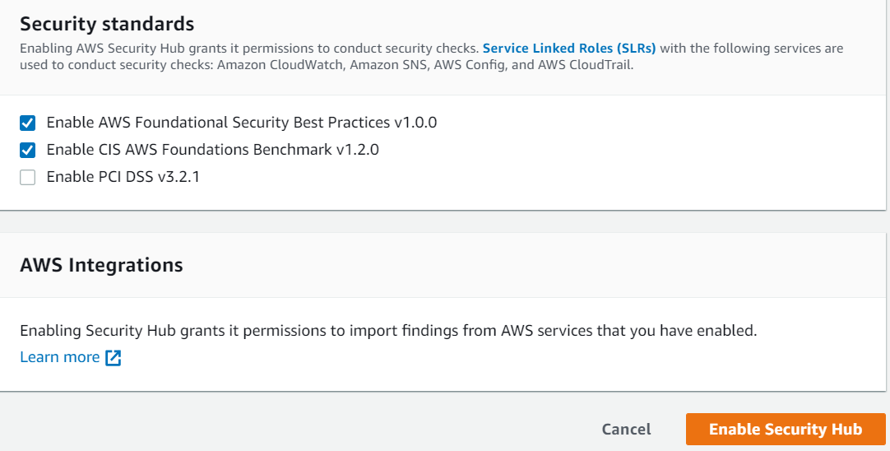
Configuration- AWS Security Hub

Slide 24
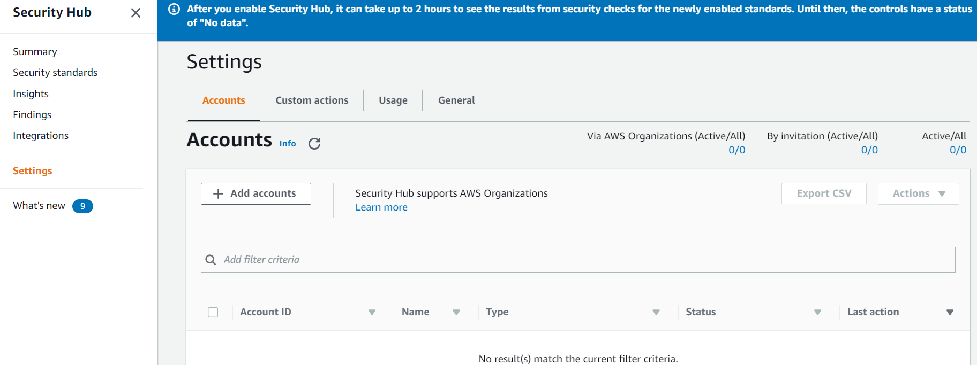
Configuration- AWS Security Hub

Slide 25
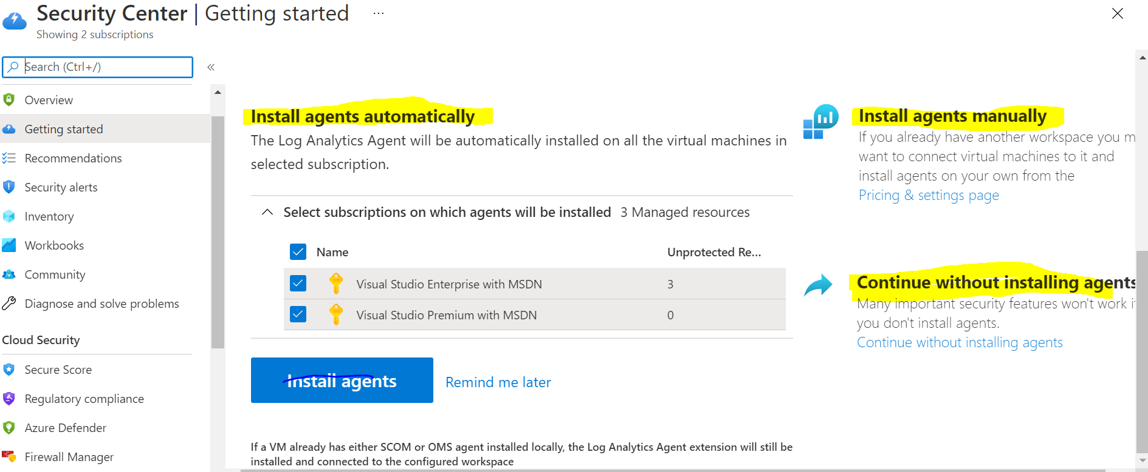
Configuration- Azure Security Centre

Slide 26
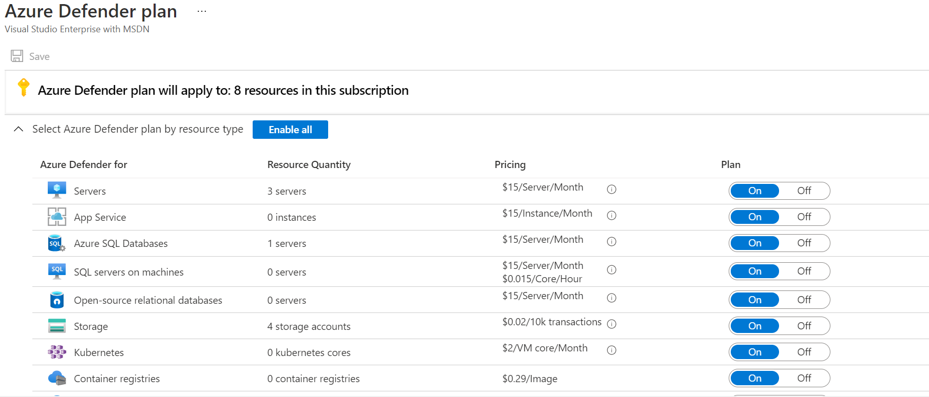
Configuration- Azure Security Centre

